Slide 1
Afro-ME-Asia Civil War
Religion or Power Politics?
Richard Hobbs
Ted Morse
Joe Shaefer
National Security Forum
17 November 2015

Slide 2
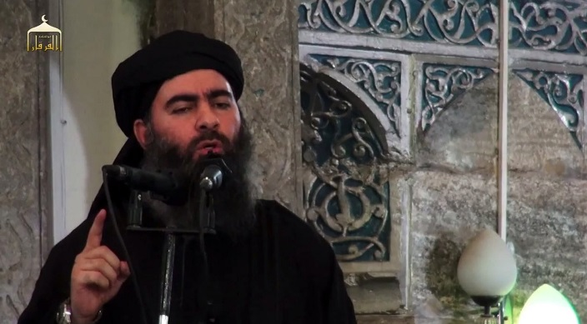
Baghdadi
the
Barbarian

Slide 3
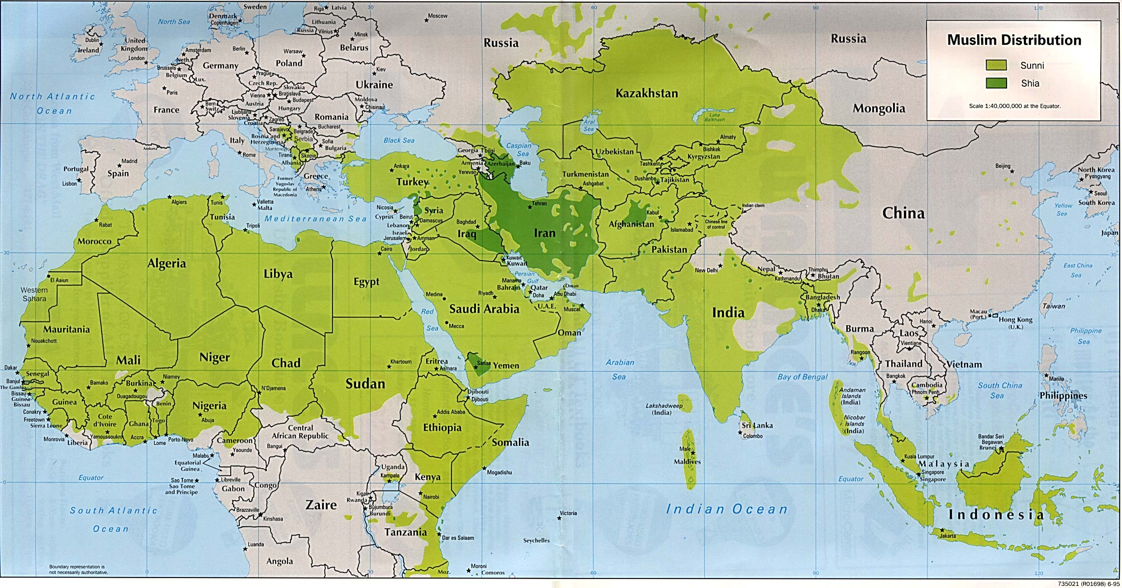
The Muslim World

Slide 4
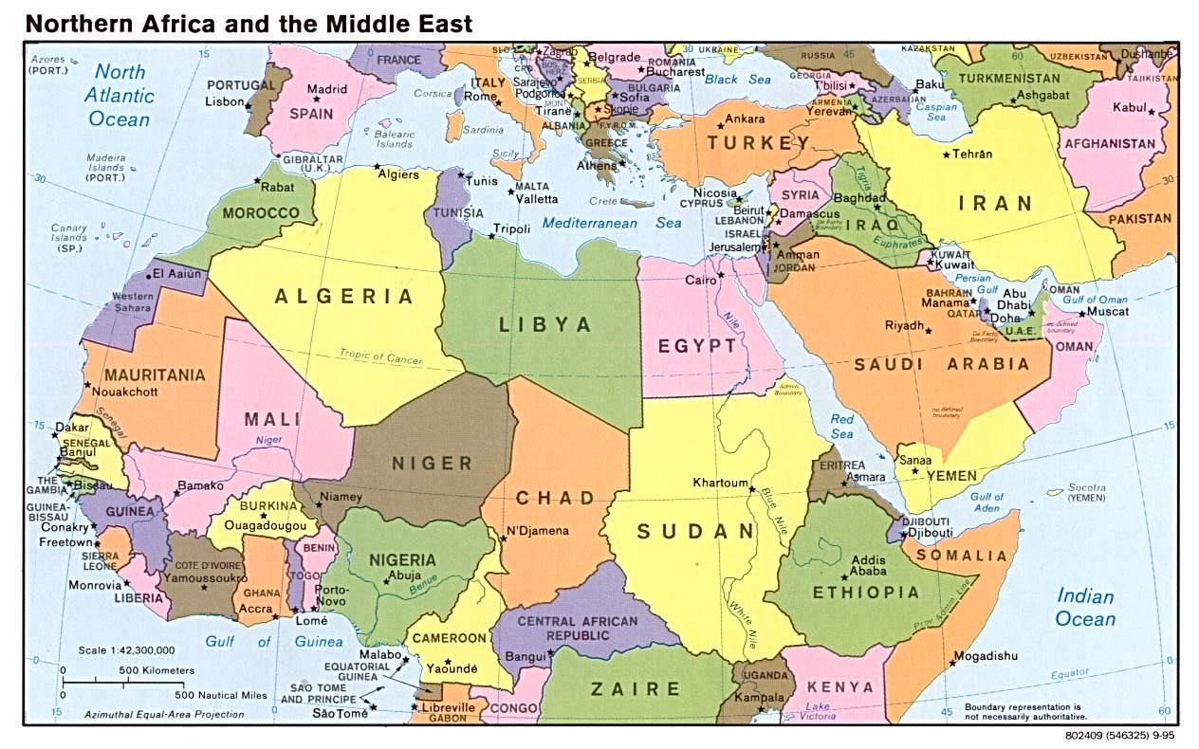
Middle East

Slide 5
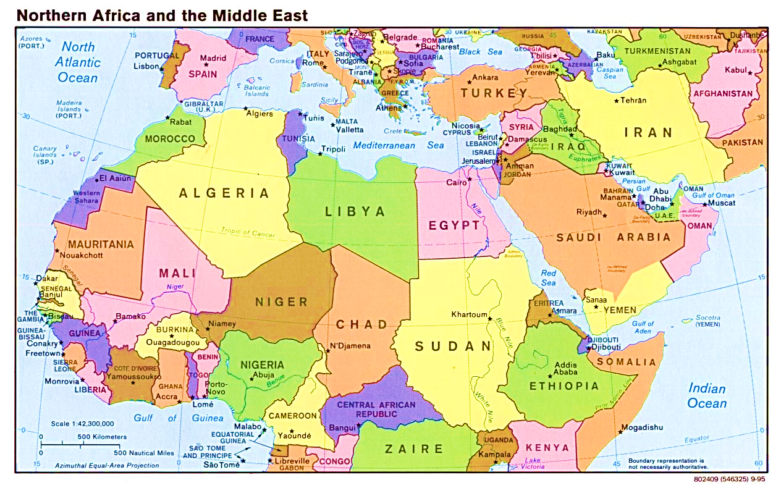
Five+ Broken Countries
Notes:
Plus Lebanon and South Sudan on the brink

Slide 6
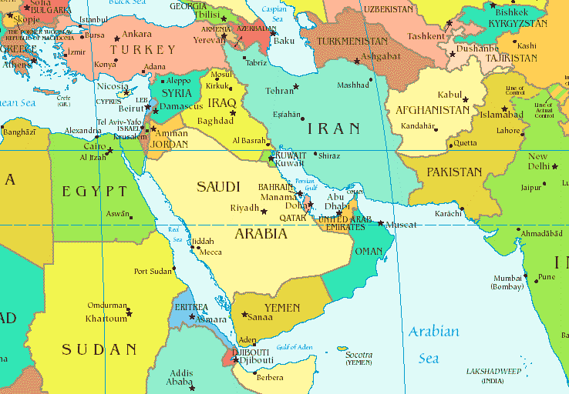
Five Centers of Power (+2)
Notes:
Plus Russia and the US

Slide 7
Two Former Empires
which once ruled the areas
and would like to reestablish their once greatness:
● Iran (The Persian or Sassanid Empire)
● Turkey (the Ottoman Empire).

Slide 8
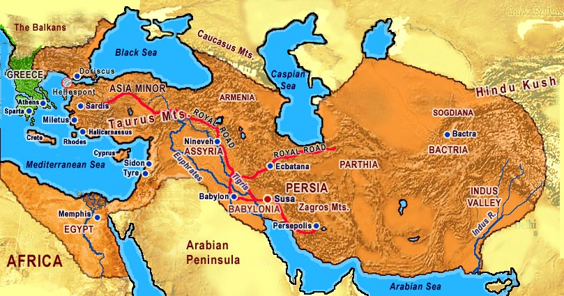
Persian Empire

Slide 9
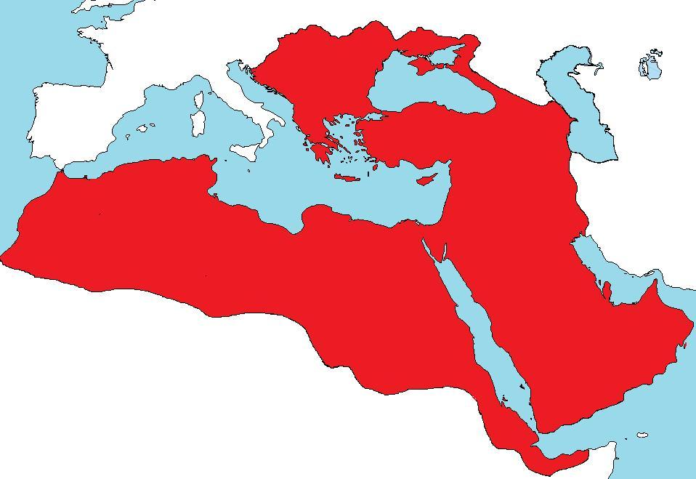
Ottoman Empire
Notes:
Constantinople seized 1453 Second Jihad stopped in Vienna 11 Sep 1683

Slide 10
Non-State Organizations
● Al Qaeda (AQIM in Africa, Al Nusrah Front in Syria,
AQAP in Yemen)
● Daesh (IS, ISIS, ISIL)
Now gaining allegiance of many groups from Africa to Afghanistan
● Free Syrian Army (if it is still viable)
● “Fighting” groups in Syria - 20 (or 30 or 40 or ?)
● Taliban
● Boko Haram (now called Islamic State in Africa)
● Al Shabaab
● Houthis, etc.

Slide 11
Single War
Atlantic to Pacific
(dozen or more sub-wars)
♦ Sunni vs. Shia
♦ Saudi vs. Iran
♦ Arab vs. Persian
♦ Islam vs. Infidels
Not fighting for democracy but to institute sharia
Notes:
A dozen or so sub-wars

Slide 12
Sub-Wars just in ME
● Syria Civil war – Sunnis vs Alawite Assad regime
● Iraq (Haider al-Abadi) vs Daesh
● Daesh vs Sunni Rebels in Syria
● Kurdish YPG (Peoples’ Protection Units) vs Daesh
● Kurdish Pesh Merga vs Daesh
● Daesh vs Assad regime
● Turkey vs YPG and PKK (Kurdish Workers Party)
● Turkey vs Assad regime & ? vs Daesh
● AQAP, Houthis vs Yemen gov’t and Saudi coalition

Slide 13
Sunni-Shia Divide
Sunnites
Followers of the Sunna
(way of the prophet)
Shiat Ali or Shiites
Party of Ali or Shia
Supporters of Ali ibn abu-Talib
(cousin and son-in-law)
Notes:
Ali married Fatima (? Beginning of inbreeding)

Slide 14
The Origins of the Islamic State
US invasion of Iraq 2003
Abu Musab al-Zarqawi

Slide 15
● Osama bin Laden [caliph] –
named him “emir of al Qaeda in the Country of the Two Rivers”
● Al Qaeda in Iraq (AQI)
● Boasted he would undo Sykes- Picot

Slide 16
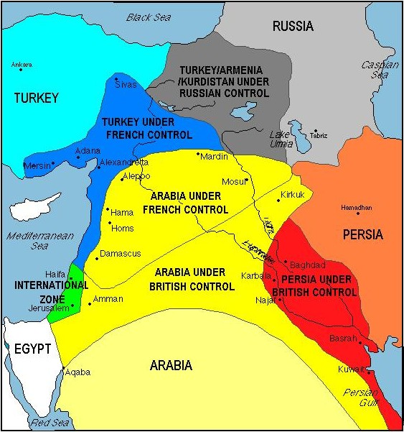
Sykes-Picot Agreement
Sykes-Picot Line
Notes:
Signed 8 May 1916 Mark Sykes and François Georges-Picot

Slide 17
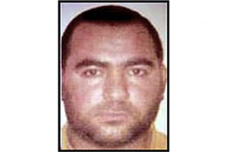
Abu Bakr al-Baghdadi
● 2005-9 Camp Bucca
● 2010 head of ISI
● 2011 ISI into Syria
● 2012 Al Nusrah Front
● 2013 formed ISIS*
● $10 Million Bounty
*Islamic State of Iraq and al-Sham (Levant)

Slide 18
Abu Bakr al-Baghdadi
Born Ibrahim Ali
al-Bakri, 1971
Doctorate in Islamic Studies
“Khalifa Ibrahim” or
Caliph Abraham
Notes:
Abu Bakr al-Saliq, first caliph. Also uses names al-Quarayshi, and al-Husseini to create ties with Quraysh tribe and Muhammad’s family.

Slide 19

“Do jihad in the cause of Allah.”
al-Baghdadi Sermon, Mosul, 4 Jul 2014
I’m the wali (leader)
ordered all Muslims to obey him
Professional media arm
Al-Hayat Media Center
Media production establishment good in English, German, etc. Videos

Slide 20

It is clear that salam (peace) is not the basis of the word Islam. Allah has revealed Islam to be the religion of the sword…. the religion of fighting.
Abu Bakr al-Baghdadi
Dabiq, Feb 2015
In response to Obama, Kerry, and Cameron

Slide 21
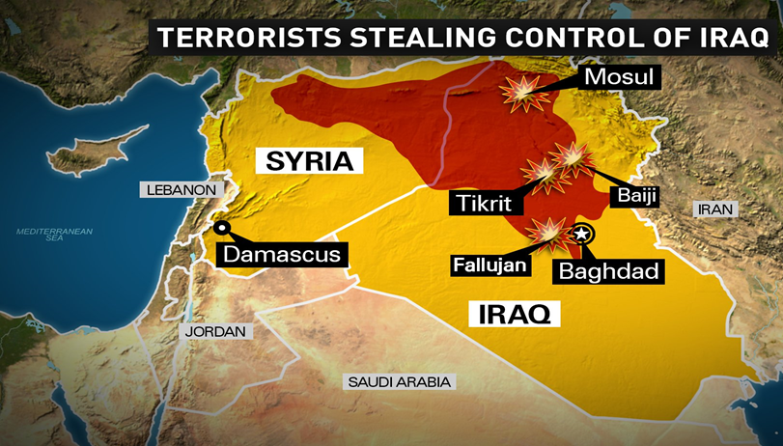
The New Caliphate

Slide 22
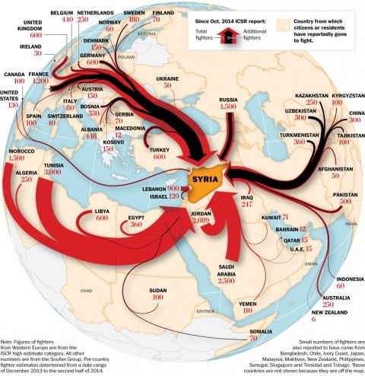
Flow of Foreign Fighters to Syria

Slide 23
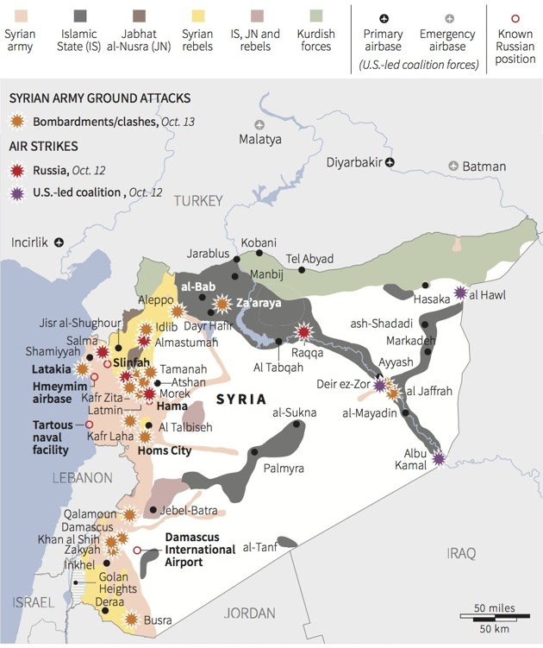
New major direct player - Russia
Notes:
Now 4,000 Russians, up from 2,000. 34 fixed-wing aircraft and 16 helicopters – 3 forward helicopter gunship bases. Some artillery.

Slide 24
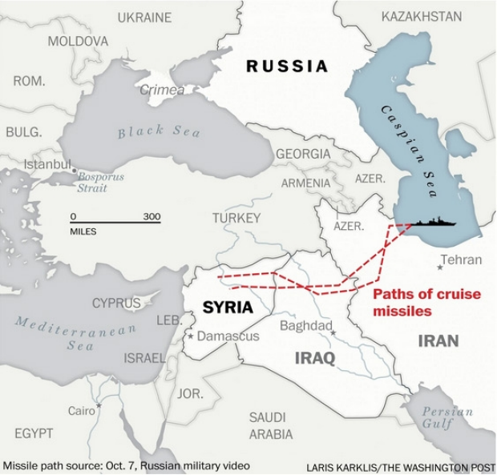
Russian Cruise Missile attack from Caspian

Slide 25
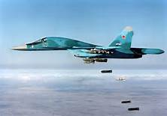
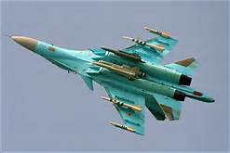
Russian SU-34 Fighter Bomber
Notes:
May be having logistics problems with spares and experience in operations. Su-30 air to air fighters. US 5,718 strikes – little effect.

Slide 26
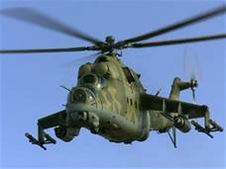
Russian Hind Gunship

Slide 27
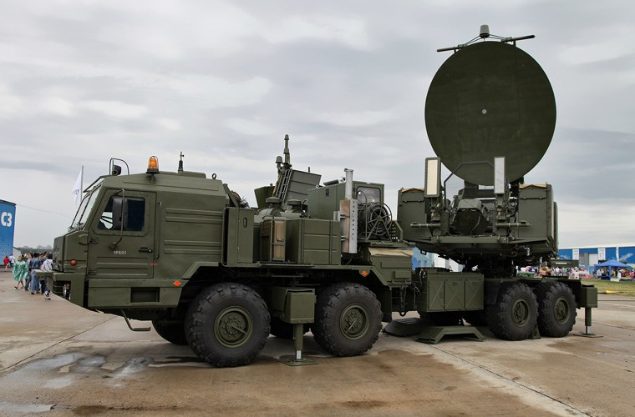
Russian Krasukha04
jams radar and aircraft - has been used during operations in Ukraine and Syria

Slide 28
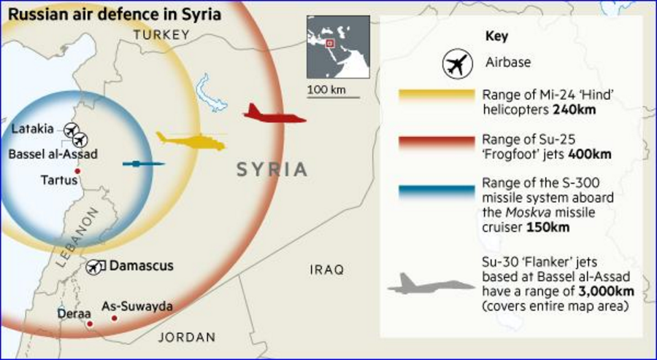
Russian Air Defense Capability in Syria

Slide 29
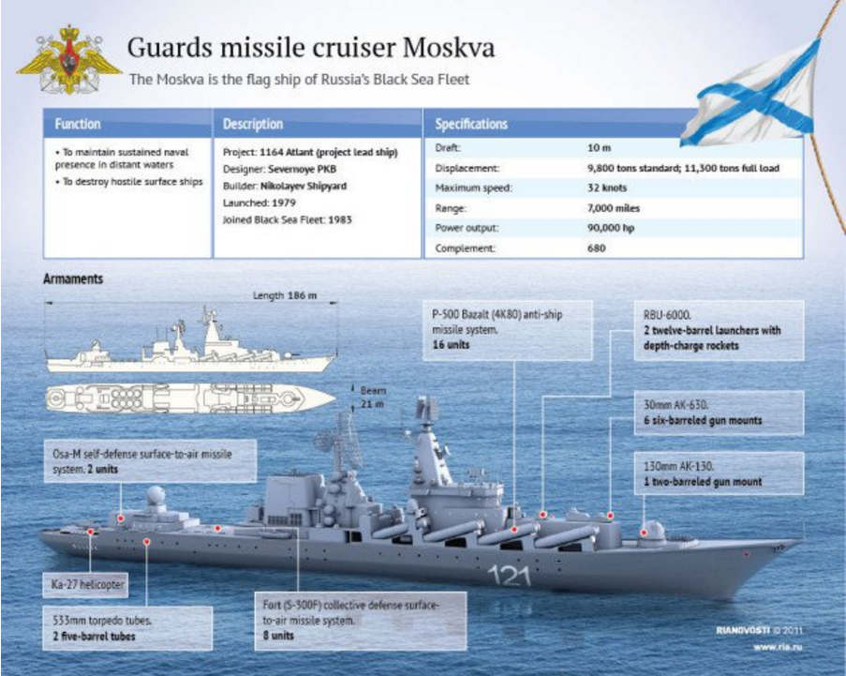

Slide 30
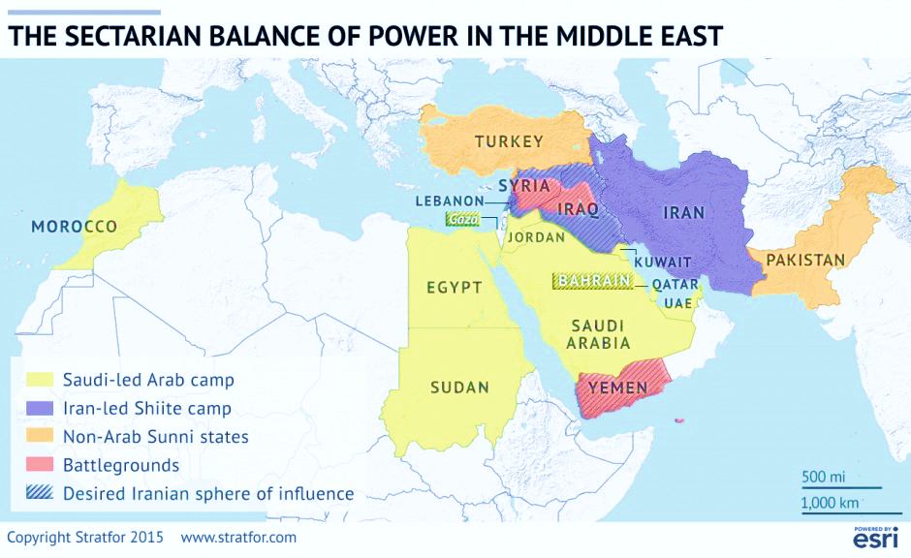

Slide 31
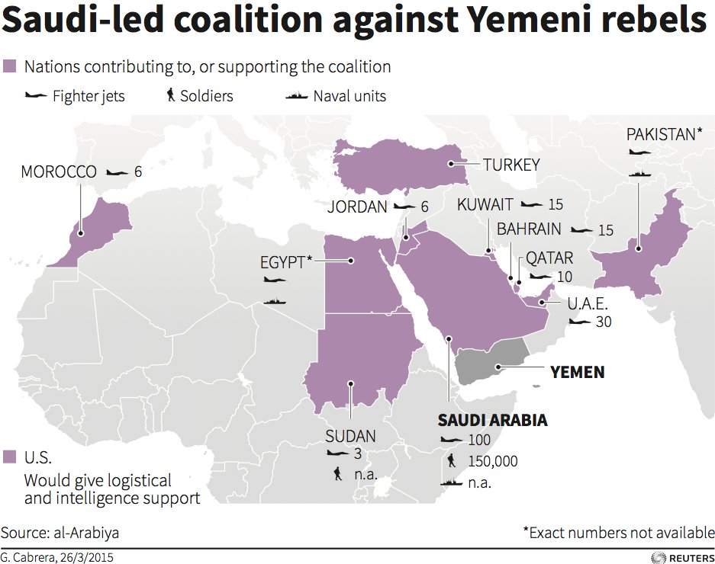
Sent 400 troops 9 Nov
Notes:
400 troops from Sudan arrived 9 Nov 15

Slide 32
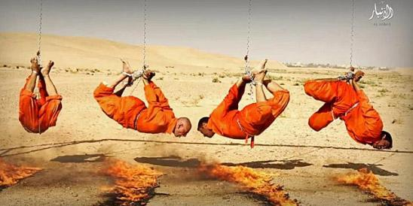
Daesh burning 4 Shia alive Aug 2015

Slide 33
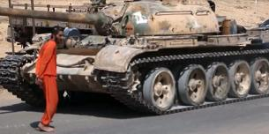
Daesh crushes prisoner under tank in horrific new video Oct 2015

Slide 34
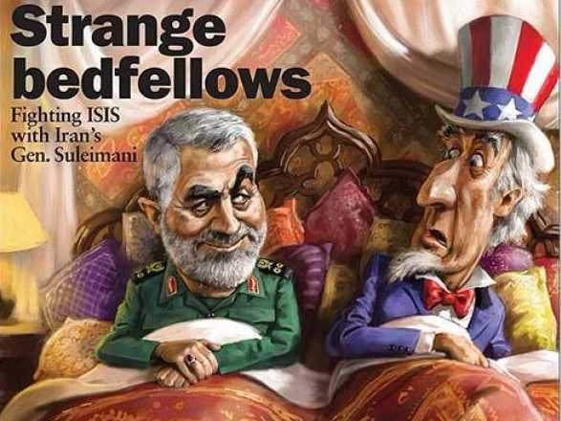

Slide 35
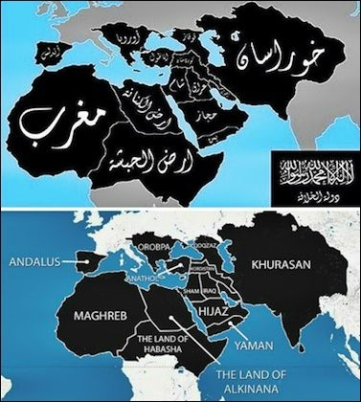
The World according to Daesh
(also known as ISIL, ISIS, IS)
Notes:
From Daniel Pipes, The Washington Times 5 August 2014

Slide 36
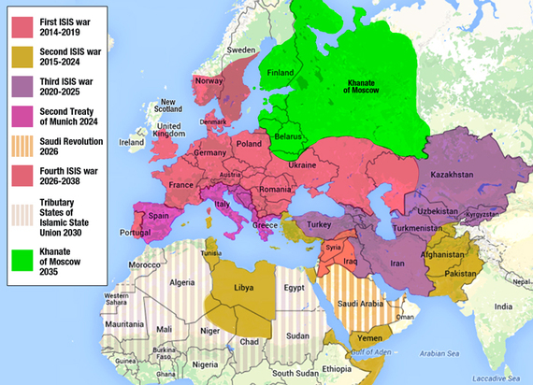
Growth of Islamic State During the ISIS Wars 2014-2047
Joseph V. Micallef Huffington Post 21 Aug 15

Slide 37
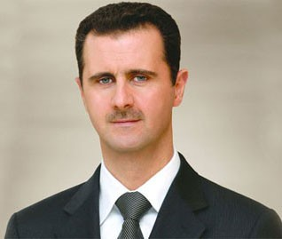
Bashar al-Assad
Political Islam has failed – called for separation of religion from politics

Slide 38
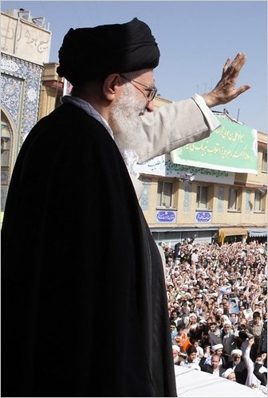
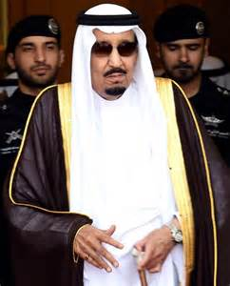
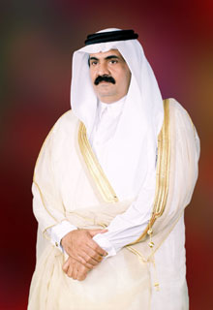
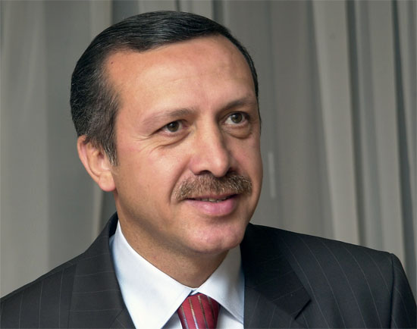
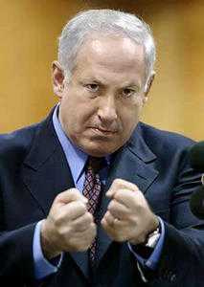
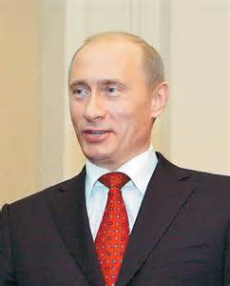
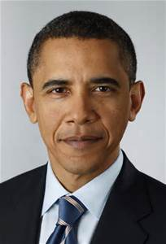
Iran Saudi Arabia Qatar Turkey
Ayatollah Ali King Salman Emir Sheikh Hamad Recip Tayyip Erdogan
Khamenei Hamad bin Khalifa al Thani
Binyamin Netanyahu Vladimir Putin Barack Obama

Slide 39
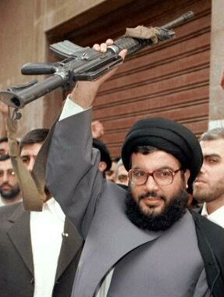
Hassan Nasrallah HezbAllah – Party of Allah
This [IS] danger does not recognize Shiites, Sunnis, Muslims, Christians, or Druze or Yazidis or Arabs
or Kurds.
This monster is growing and getting bigger.

Slide 40
Significance
● Syria, Iraq, Libya, Yemen – gone
● Lebanon – once Christian – with HezbAllah now Shiite
● Syria – Russian-Iranian support
● Jordan – 1M Syrian Sunnis – Palestinians now minority
● Iraq – “Shiastan, Jihadistan, and Kurdistan”

Slide 41
Wake Up World
The barbarians are at the gates – some are already in!

Slide 42
The Complex Wars
and
Armed Groups in Syria
Ted Morse

Slide 43
I. Think of three (3) Wars in Syria
● Political- part of the Arab spring
● Religious-ISIL take-over of Syria
● International Caliphate war base in Syria
II. Battlefield war and Hegemonic competition
III. Four Types of Armed Groups Fighting in Syria
● Assad Regime and allies
● Syrian Opposition and allies
● ISIL Forces and allies
● Other Jihadist fighters in Syria
IV. Conclusion

Slide 44
Sub-Wars in Syria
● Syria Civil war – Sunnis vs Alawite Assad regime
● Daesh vs Shia/Sunni Rebels in Syria
● Kurdish YPG (Peoples’ Protection Units) vs Daesh
● Syrian Opposition vs Assad Regime
● Daesh/Al Nusrah vs Assad regime
● Turkey/Saudi Arabia/Jordan/Qatar vs Assad regime

Slide 45
I. Think of three (3) Wars in Syria
● Political- part of the Arab spring
● Religious-ISIL take-over of Syria
● International Caliphate war base in Syria
II. Battlefield war and Hegemonic competition
III. Four Types of Armed Groups Fighting in Syria
● Assad Regime and allies
● Syrian Opposition and allies
● ISIL Forces and allies
● Other Jihadist fighters in Syria
IV. Conclusion

Slide 46
CENTCOM Chief Intelligence Officer, briefing the new Chairman of the U.S. Joint Chiefs of Staff:
5 key things the Chairman needs to know about regional conflicts in this combat zone
Joe Shaefer

Slide 47
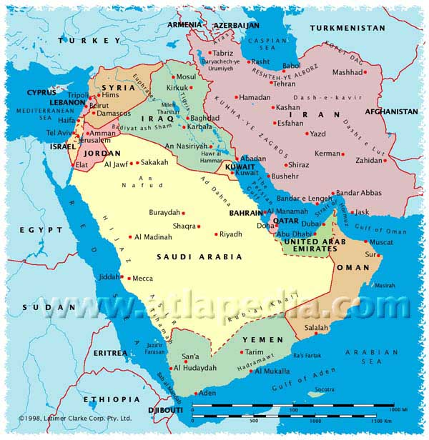
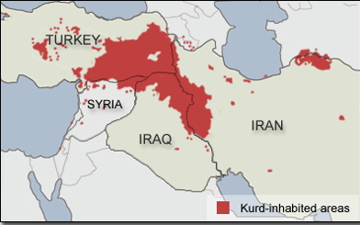

Slide 49
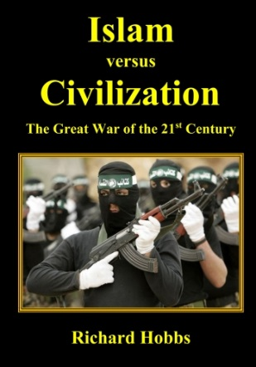

Slide 50
