Slide 1
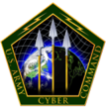
Cyber-Warfare: The Future is Now!

Slide 2
Agenda
BLUF - Bottom Line Up Front
Cyber-Warfare - 5Ws
Cyber-Threats and Targets
Economic Impact and Cyber-Law
Questions

Slide 3
BLUF
(Bottom Line Up Front)
Significantly increased over the last decade
Frequency, scale, sophistication, and severity of impact
Thousands of attacks daily
~240 New forms of Malware released each day
Requires minimal cost and effort
Malicious Tools easily found on the “DarkNet” at minimal cost
Can impose a tremendous amount damage and confusion on a global scale.
Reliant on technology, even minor attacks can be catastrophic and debilitating

Slide 4
What is Cyber-Warfare
5th Dimension of War
Probing or penetration attack
On an individual computer or a computer network system through the Internet
Exploit weakness, steal information, or conduct sabotage.

Slide 5
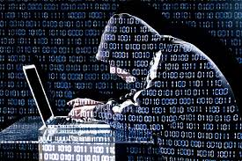
Who is the Enemy
Individual Hackers
Hacktivist Groups
Criminal Organizations
Corrupt Businesses
Terrorists
Foreign Military or Government

Slide 6
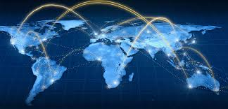
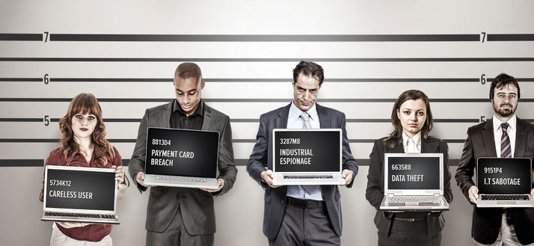
Types of Threat
External: Most Likely
Insider Threats: (Difficult to Identify)
Malicious / Intentional / Unintentional / Consequential

Slide 7
Types of Attack
Point of Sale Attacks: 28.5%
Crimeware: 18.8%
Computer Espionage: 18.0%
Privilege Misuse: 10.6%
Web Applications: 9.4%
Miscellaneous: 14.7%
SOURCE: Verizon Data Breach Investigations Report (DBIR) 2015
Notes:
Malicious Code
Denial of Service
Theft / Fraud
Espionage
Sabotage / Destruction

Slide 8
Cyber-Targets
2015 # Breaches / # Records
Medical / Healthcare - 129 / 100 Mil
Government / Military - 27 / 47 Mil
Education / Research - 31 / 724K
Banking / Financial - 39 / 408K
Small, Medium, Large Business - 154 / 121K
Energy / Utilities - 79 /

Slide 9
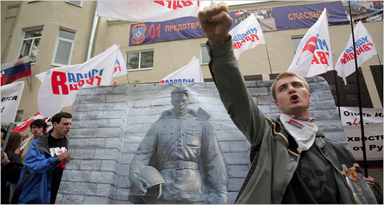
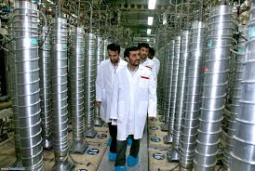
Previous Attacks
2007: Russia / Estonia - DDOS - Sabotage
2010: U.S. / Iran - Stuxnet Worm- Sabotage
2013: Iran / U.S - Natanz - Retaliation - Theft / Fraud

Slide 10
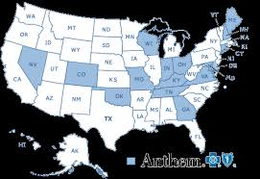
Recent Attacks
2014: Anthem / Unknown
Theft 80 mil medical records
2015: China / U.S - OPM - Theft
Outsourced Domain Administration Support to Foreigners:
System Administrators from: China and Argentina
Both had ROOT Privileges.
NO HACKING REQUIRED!
Encryption Would NOT have helped!

Slide 11
Economic Impact
Cost of Cyber-Crime
Lost profits
Minimal public spending due to lost trust
Destruction of the Financial System

Slide 12
Cyber-Law
Domestic Law
International Law
Laws of War
Rules of Engagement - Kinetic / Electronic

Slide 13
Take Away
Increase cyber education and training
Increase budgets and funding
Increase vigilance
Notes:
Malicious Code
Denial of Service
Theft / Fraud
Espionage
Sabotage / Destruction

Slide 14
Questions

